Slide 1
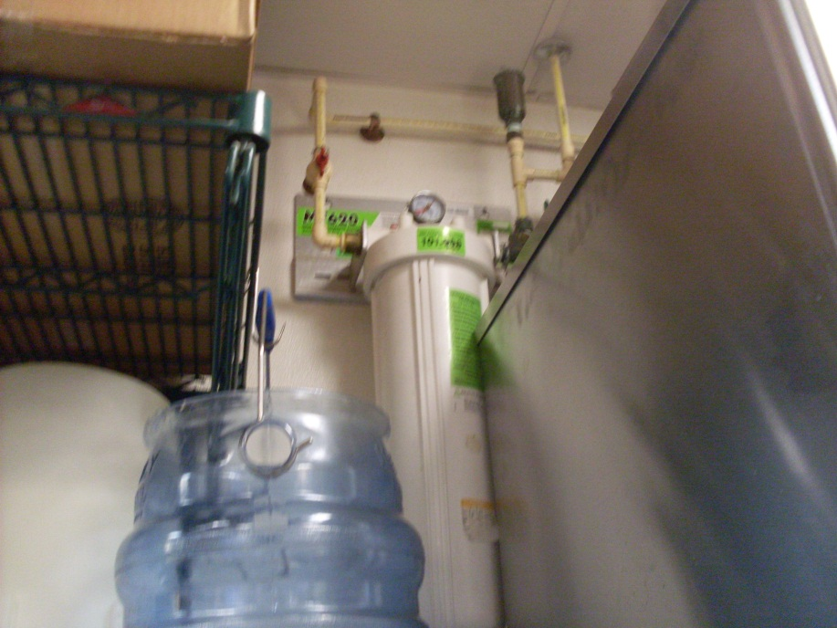
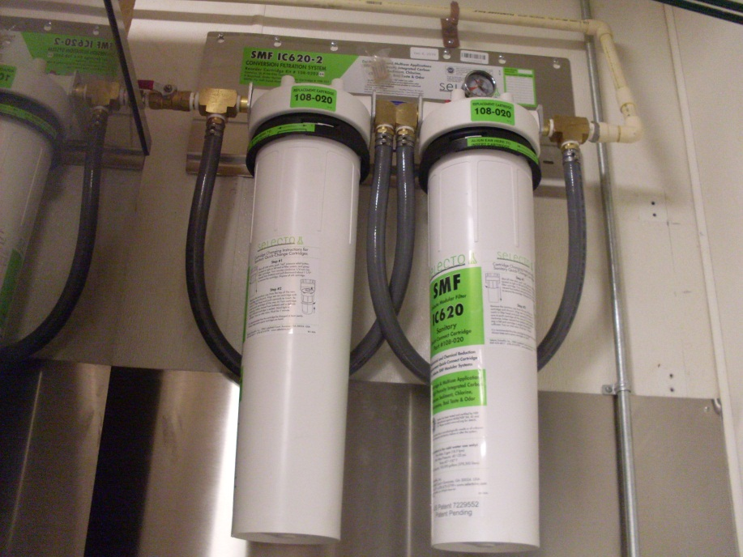
1680 in JAX
January 27, 2011
Jeff and Craig visit location
Ice machine filtration inspected by both of us
We found nothing wrong with it
No good pics above the ice machine, but I think this is the inlet for the teabrewer filter,
and it looks like that could be the same line that runs above and to the right of the ice machine filters.
If the ice machine filtration was plumbed backward, that would mean that we both missed this during our visit there.

Slide 2
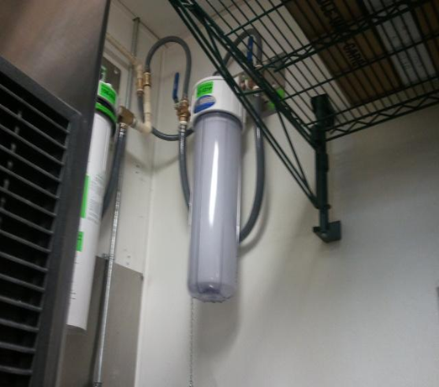
1680 in JAX
March 9,2011
Wayne Anderson’s company shows up and installs a prefilter on the ice machine-
Looks like he is prefiltering AFTER the SMFIC620-2 (if that is really the outlet side).
BUT…..if the SMFIC620-2 is plumbed backward, then Wayne plumbed the prefilter backward, too (in the outlet, out the inlet)
I think the plumbing for the filtration was correct, and Wayne goofed up the prefilter installation.

Slide 3
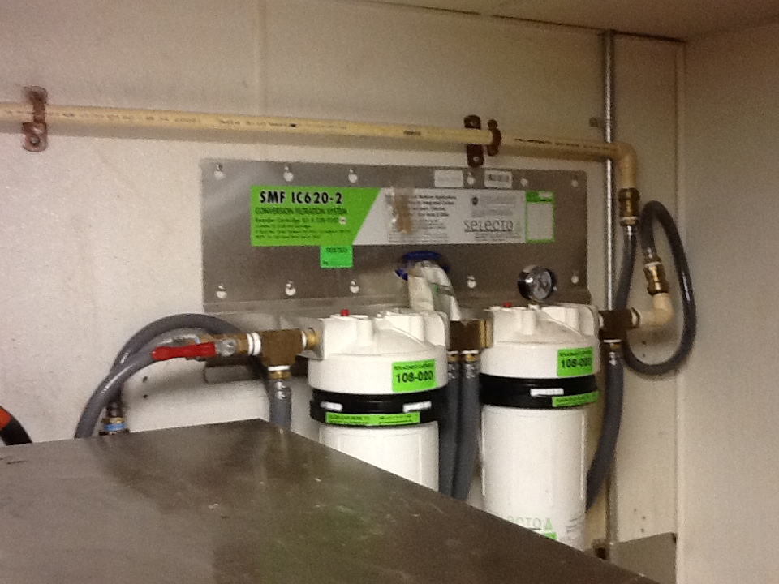
1680 in JAX
August 21,2012
PB&J shows up and reports that the ice machine filtration is backward. They are instructed to correct this and remove the prefilter.
They eliminated the prefilter and looped back with Accuflex.
But the right side of the filters are still going to the same tubing as before.
I think once they saw the plumbing, it was plumbed correctly, and then they only had to eliminate the prefilter to make it correct.
Am I right?

